Slide 1





WOMEN IN TECH PROGRAM

Slide 2


Flight Booking System
Name : Narges Saeed
Tutor Name : Mulham
Mentor Name : Mohamad Issa

Slide 3

PROJECT OBJECTIVES AND GOALS :
Objective : Create Command Line Interface-based system for flight booking management .
Goals:
Simplify flight search/booking with minimal UI .
Ensure data persistence using JSON .
Handle concurrent bookings safely .
Provide error-resistant user input handling .
Show how flight booking systems work behind the scenes, valuable for understanding travel technology .
Demonstrates automation concepts, like quick flight searches and bookings, which can save time in real-world systems .

Slide 4


PROBLEM STATEMENT AND PROPOSED SOLUTION WITH TARGET AUDIENCE :
Problem :
Time-Consuming Process :
Average flight booking takes 15-20 minutes on commercial platforms .
2 . Accessibility Issues :
Elderly/non-tech users struggle with visual-heavy interfaces .
Mobile responsiveness challenges in rural/low-bandwidth areas .
Solution :
Solution:
Cuts booking time to <2 minutes with minimal inputs .
Target Audience:
Casual travelers:
"I just need a ticket from A to
B tomorrow"
Senior citizens:
"I want to book without
zooming/clicking tiny buttons"
Works on any device (even legacy computers) .

Slide 5



COMPETITE ADVANTAGE:
For small travel agencies or startups , the system could provide a cost-effective way to offer basic flight booking service internally .They can use it for internal operation , such as managing bookings
for a small client base , until they can afford or develop a more advanced system.

Slide 6

METHODOLOGY AND TECHNOLOGIES :
procedural programming with functions for each feature .
Python , JSON for data storage ,standard libraries like json and datatime .
Core: Python 3.10+
Storage: JSON files (NoSQL-like structure)
Libraries:
- datetime (time manipulation)
- json (data serialization)
- os (file existence checks)

Slide 7



KEY FEATURES AND FUNCTIONALITIES :
Intelligent Flight Search
Booking Workflow
Booking Retrieval

Slide 8
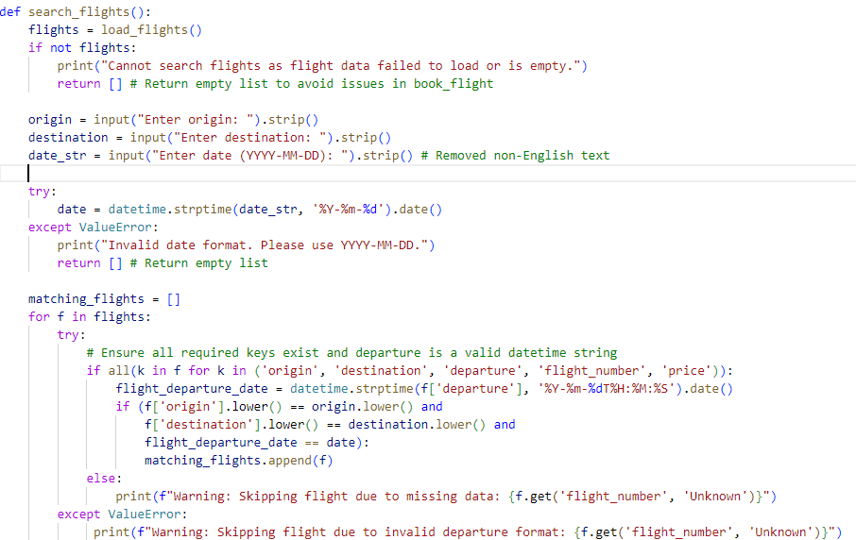
Intelligent Flight Search :
User input collection :
Input () captures user text input .
.Strip() removes leading/trailing whitespace
(fixes accidental spaces) .
. lower() converts to lowercase for
case-insensitive matching .
Flight Filtering :
Iterates through all flights (flights list):
Three matching conditions: a) Origin match (case-insensitive) . b) Destination match (case-insensitive) . c) Date match (ignoring time component .

Slide 9
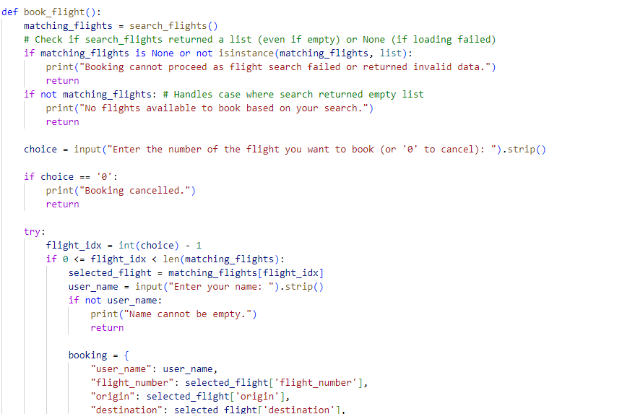
Booking Workflow :
Flight Selection Process :
Key Points
Reuses search_ fights() to ensure consistency
Implements guard clause pattern for empty
results
Input Validation & Error Handling :
try / except catches non-integer inputs .
Index bounds checking prevents
out-of-range errors .

Slide 10
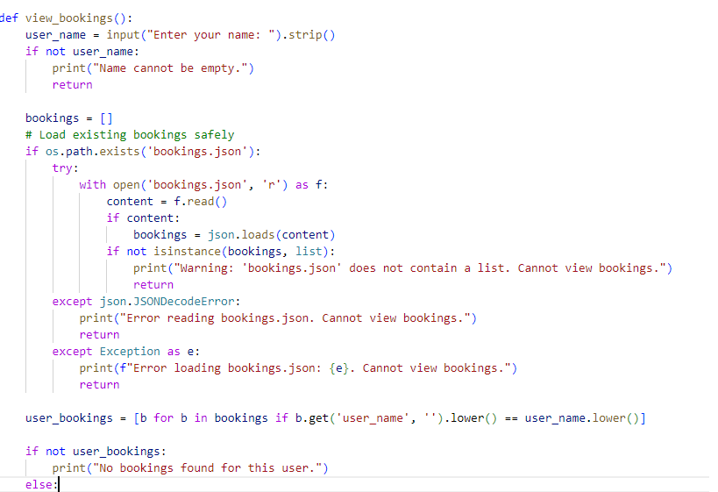
Booking Retrieval:
User Input Collection & Validation :
Key Features:
.strip()removes accidental leading/trailing
spaces .
Explicit validation prevents null entries .
Early return pattern avoids nested conditions .
Data Loading with Error Handling :
Safety Mechanisms:
os.path.exists prevents FileNotFoundError .
Try-catch handles malformed JSON .
Returns empty list if no file exists
(fail-safe design) .

Slide 11

CHALLENGES FACED AND HOW I OVER CAME THEM:
Challenge 1: Date format synchronization .
.
Solution : Dual-layer validation with data time module .
Challenge 2: Concurrent file access .
Solution : Atomic write operations with Json.dump() .
Challenge 3: Case-sensitive user names .
Solution: Unified lower () normalization .

Slide 12

ADDED VALUE AND INNOVATION ASPECT : :
JSON-as-DB: File-based storage for zero-config setup
CLI Optimizations:
Single-character navigation .
Instant search feedback .
Machine-readable outputs .

Slide 13
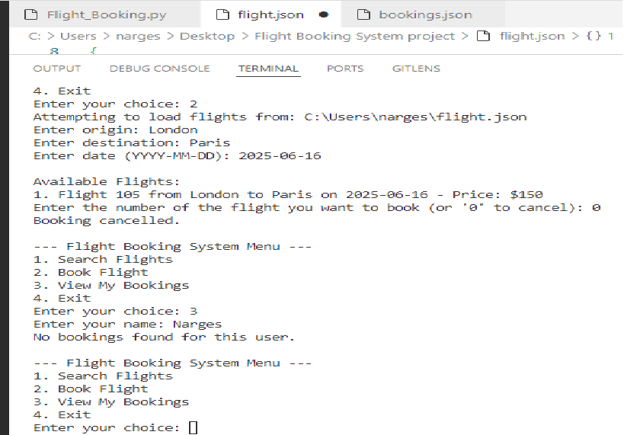


Out outputs
LIVE DEMONSTATION PLAN :
Search → Yemen to New York on 2025-06-15
2 . Book flight → Test User .
3 . Verify booking → Test User .
4 . Edge case demo → Invalid date input .

Slide 14

FUTURE ENHANCEMENTS :
Add seat selection logic .
Implement price comparison engine .
Develop REST API layer .
Build web interface (Flask/Django) .
Add cancellation policies .

Slide 15

CONCLUSION AND ACKNOWLEDGMENTS :
Our system builds on Python's robust standard libraries,
requiring no external dependencies – this ensures easy installation and offline use.
The JSON format was chosen for its human-readability,
making it accessible to travel agencies who might need manual edits.
Acknowledgments :
Python Software Foundation for robust standard libraries .
Open-Source Community for JSON/datetime documentation .
Beta Testers for real-world feedback .

Slide 16
References:
1. Core Technologies
2 . Development Tools
Resource | Purpose | Documentation
Python 3.10+ | Base language | python.org/doc
JSON | Data storage format | json.org
datetime | Date handling | Python datetime
os | File operations | Python os
Tool | Usage
VS Code | Code editor
Git | Version control
Pylint | Code quality check

